Slide 1
Sprint 5
kepper FM Project

Slide 2

Project Introduction
Client: Keppel FM, a Non-profit radio station community
Requirement: Update current website
Concerns of the website:
More user friendly
Simple for staff to manage with little training

Slide 3
Project Objectives
1
2
3
Attractiveness
Quality
Efficiency
more attractive and easier
high standard and quality
Get rid of redundant data
4
5
6
User Friendly
Easy to Learn
Convenient
More user friendly
Staff can use it with little training
Navigation needs to be more convenient

Slide 4
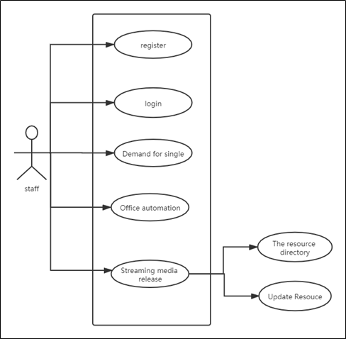
User Story - individual use cases

Slide 5
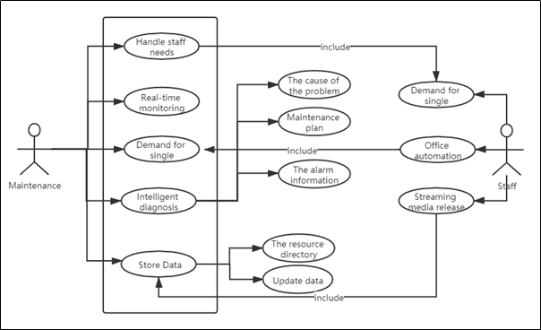
User Story - Maintenance function

Slide 6
User Story - all interaction

Slide 7
User Story and Function
Function: View the current page status
User story: as a website user, I want to see all the media information on the website so that I can have a broad understanding of the media content.
Run the following command to delete a media
User story: as a website user, I would like to press Delete media information to facilitate the removal of unsatisfactory media content.

Slide 8
User Story and Function
Function: Run the following command to export selected media content
User Story: As a website user, I want to export media information so that it can be easily downloaded.
Function: Run the following command to manage user information
User Stories: As an administrator, I want to manage user information so that it is easy to maintain user data.

Slide 9
Monitoring and Reporting
01
02
03
Weekly Status Report
Project status meeting
Project owner status meeting
Report weekly status to ensure everyone is on the same page
Communicate on current status and challenges
Report and discuss current problems

Slide 10
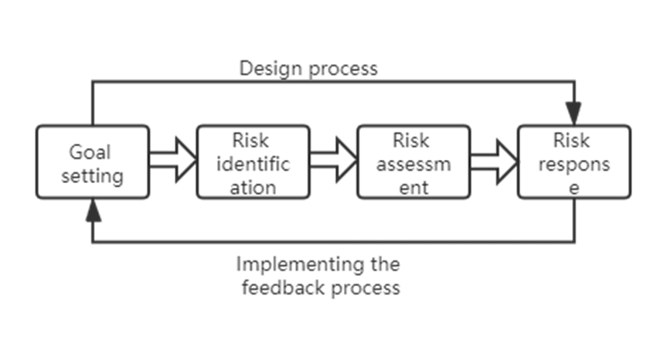
Risk Management Process

Slide 11
Type of risk Identified
A
C
Deman range risk
Risk of poor communication
B
D
Personnel experience risk
Team ability and quality risk

Slide 12

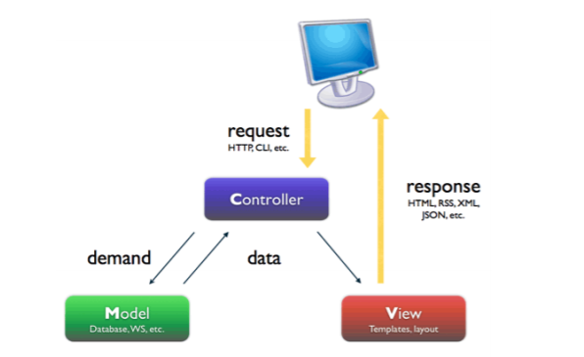
Website MVC Diagram

Slide 13
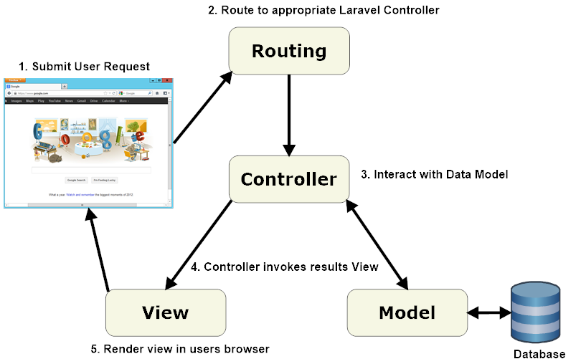
Software Architecture

Slide 14
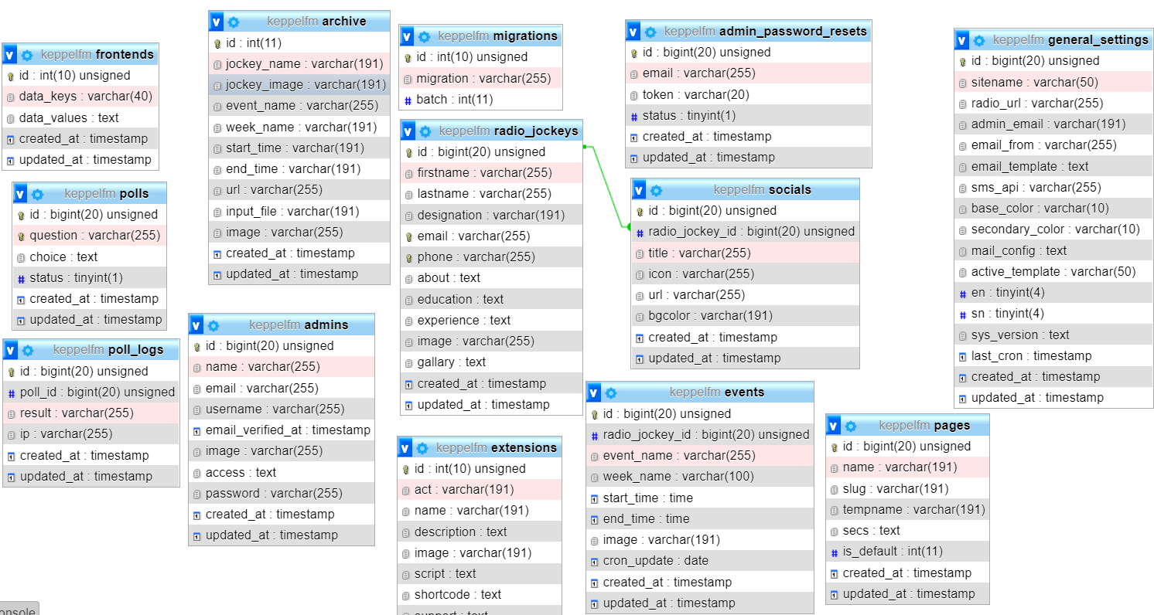
Database Design

Slide 15
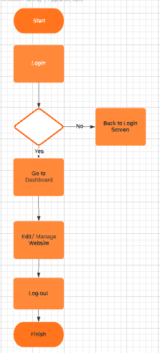
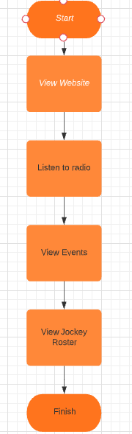


Behaviour Modelling
Admins
Visitors

Slide 16
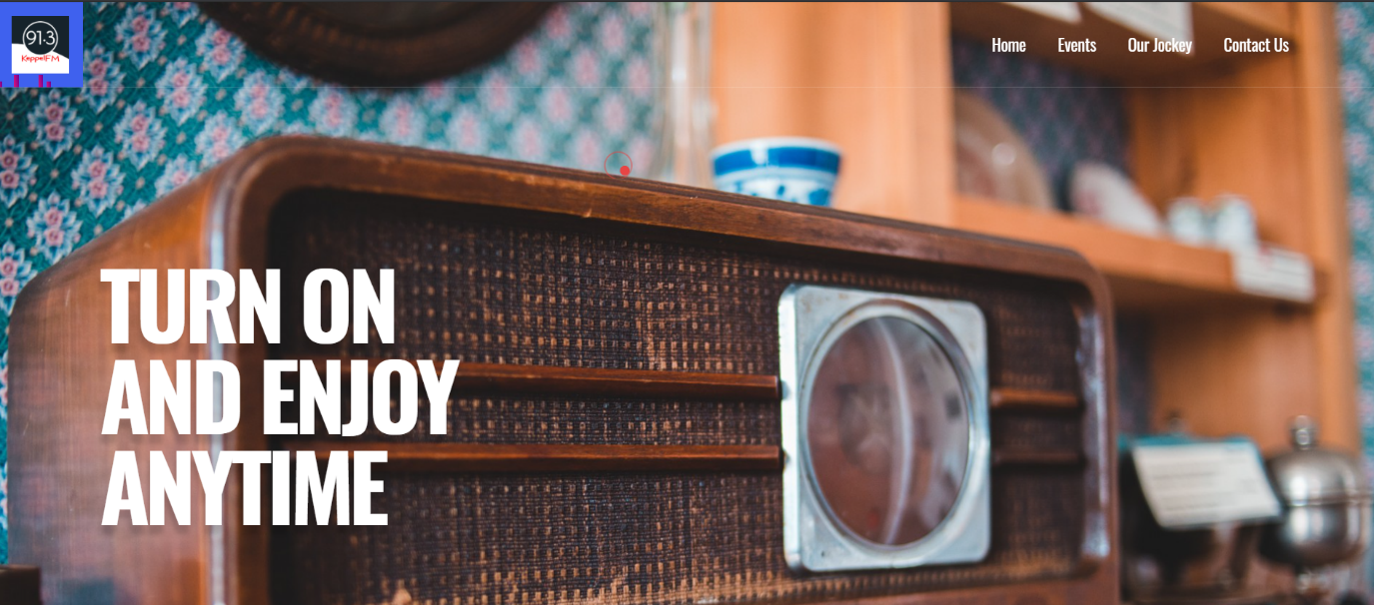
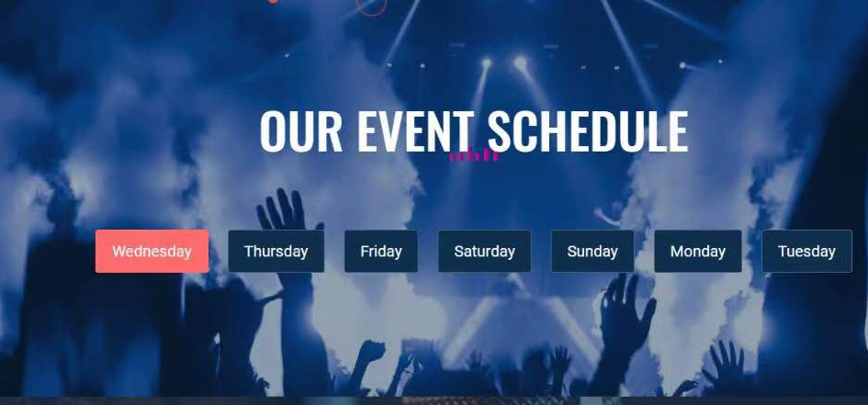
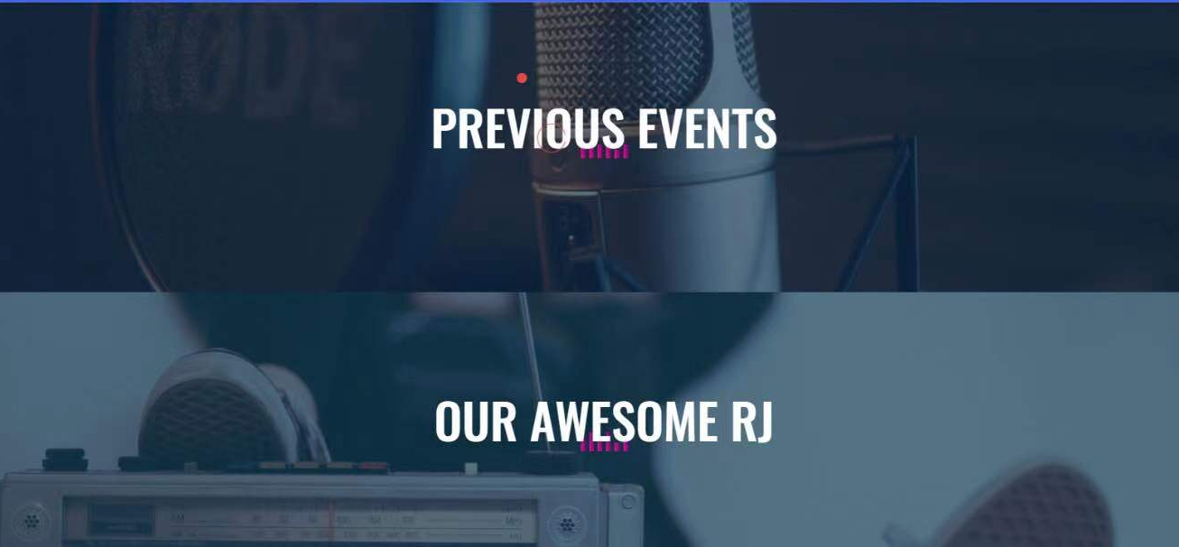
Prototype – Home Page

Slide 17
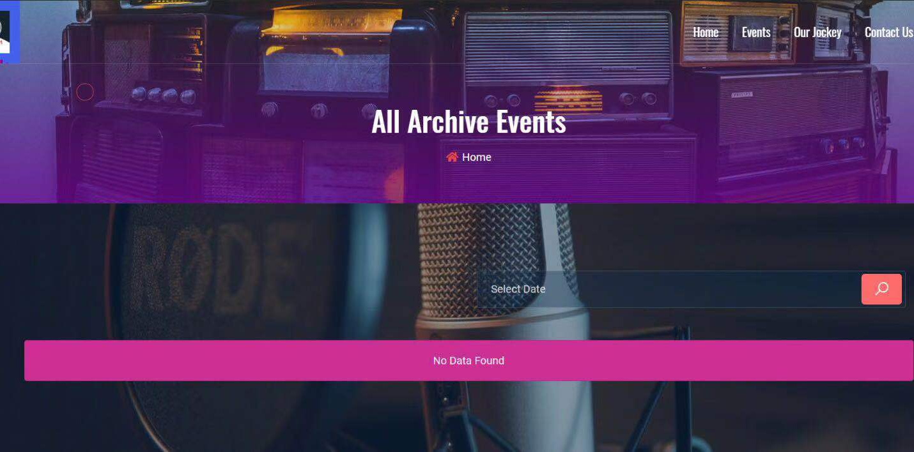
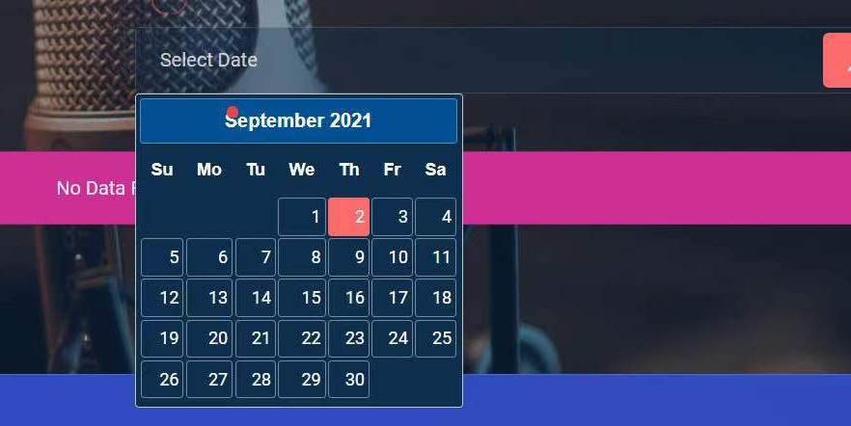
Prototype – Event Page

Slide 18
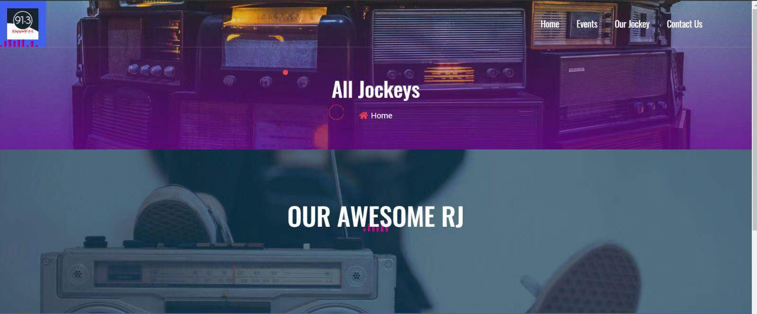
Pprototype – Jockey

Slide 19
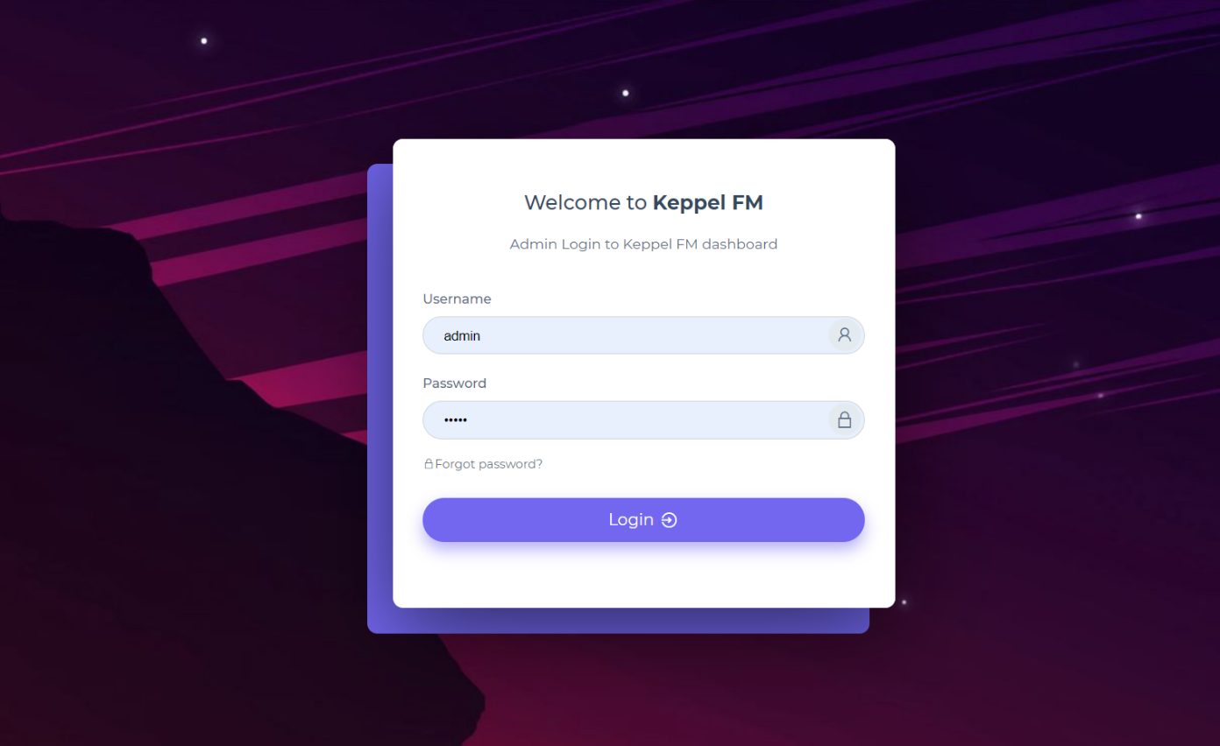
Prototype – Admin Login

Slide 20
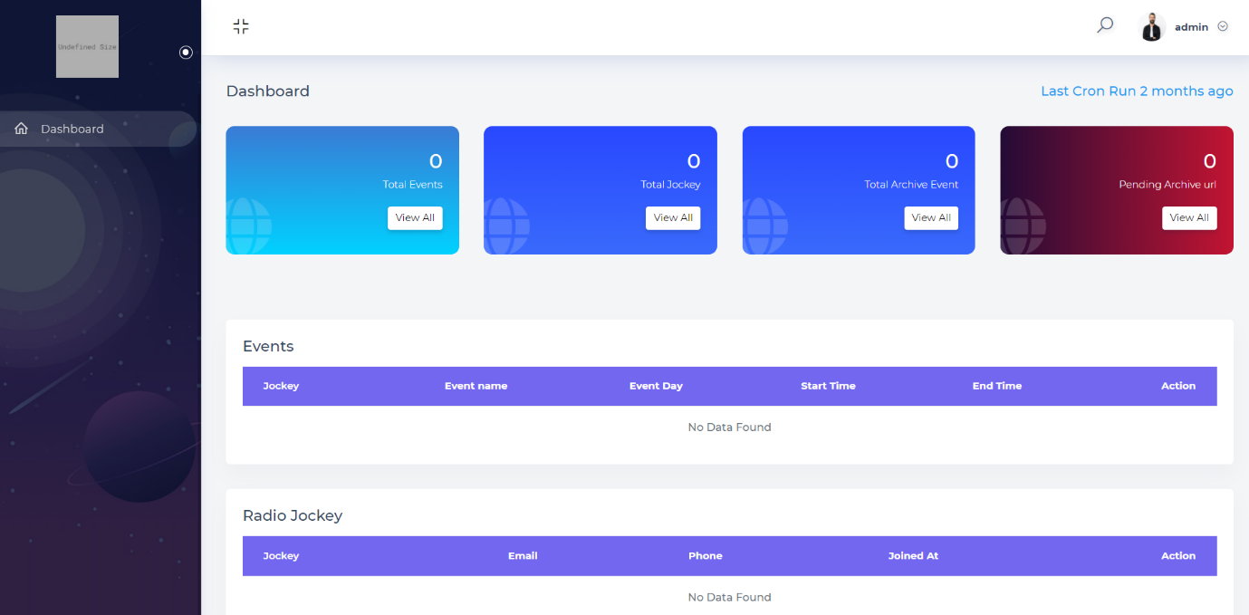
Prototype – Admin Dashboard

Slide 21
Thanks

